Slide 2
Organic Electrochemical Transistors (OECT) combined with enzyme glucose dehydrogenase as glucose sensors
Emmanuel Joseph Shaji
Bremen 11/11/2025

Slide 3

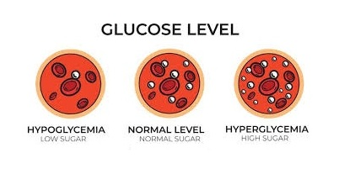

Motivation Slide
Masters Project Emmanuel Joseph Shaji
11/11/2025
Glucose is essential carbohydrate that serves as a primary energy source for most living organisms. It helps in:-
Diagnosis :- Diabetes, hyperglycemia and hypoglycemia.
Health Monitoring :- Physical energy and Cognitive function.
Source: Google images
1

Slide 4
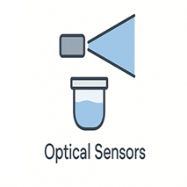

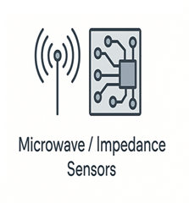
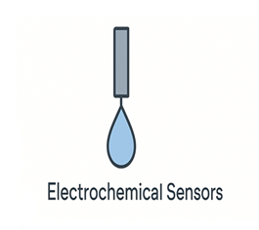
Motivation Slide
Masters Project Emmanuel Joseph Shaji
11/11/2025
Non invasive
Non invasive
Non invasive
High sensitivity
Expensive
No real time detection
Complex circuitry
Invasive
2
Notes:
Optical glucose sensing: Detects glucose through changes in light absorption, fluorescence, or scattering caused by glucose–enzyme or glucose–indicator interactions.
Urine/Saliva glucose testing: Determines glucose concentration by measuring the color change of a dye after enzymatic oxidation, compared to an optical or color reference.
Microwave/Impedance glucose sensing: Senses glucose by monitoring variations in dielectric properties or impedance of the sample as glucose concentration alters its conductivity and permittivity.
Electrochemical glucose sensing: Measures electrical current or potential generated by the enzymatic oxidation of glucose, proportional to its concentration.

Slide 5
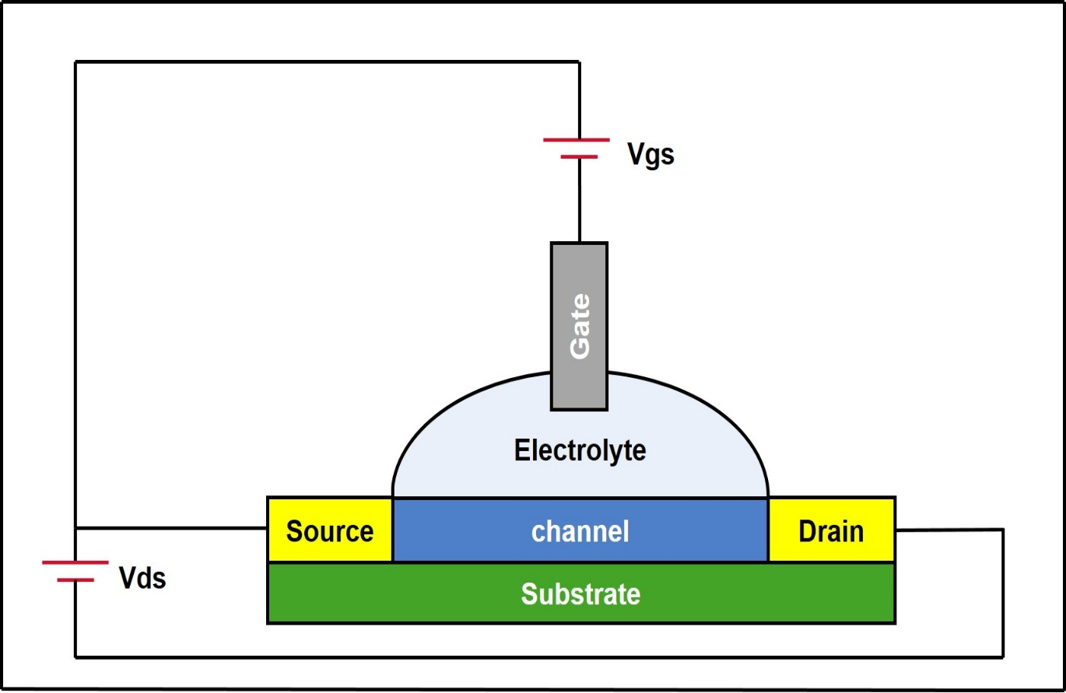
New candidate platform OECT
Masters Project Emmanuel Joseph Shaji
11/11/2025
Working Principle
Advantages
Low power consumption
Real time monitoring
Low cost
Flexibility and biocompatibility
Reduced invasiveness
3
Notes:
. Ion injection from an electrolyte into an organic semiconductor channel to modulate its conductivity, thereby controlling the drain current in response to a gate voltage.

Slide 6
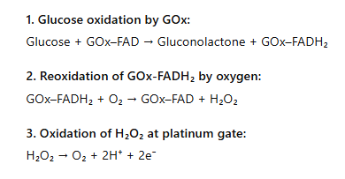
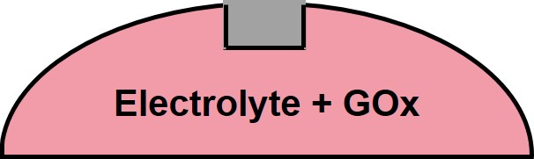
GOx-OECT
Masters Project Emmanuel Joseph Shaji
11/11/2025
What is GOx?
Challenges
GOx
Reproducibility Issues
Stability Concerns
GOx
Oxygen Dependence
Hydrogen Peroxide Byproduct
4
Notes:
.Widely used enzyme for glucose sensing-GOx (Glucose Oxidase) is an enzyme that specifically oxidizes glucose to produce H₂O₂, which generates a measurable electrical signal proportional to glucose concentration

Slide 7
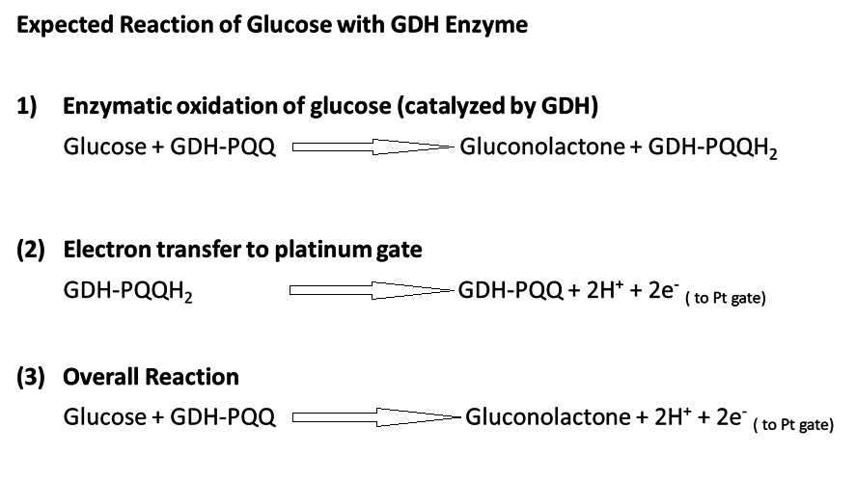
GDH- an alternative for GOx?
Masters Project Emmanuel Joseph Shaji
11/11/2025
What is GDH?
Advantages
No H₂O₂ By-Product
25 times higher activity than GOx
No oxygen needed
5
Notes:
. GDH (Glucose Dehydrogenase) is an enzyme that catalyzes the oxidation of glucose using a cofactor (like PQQ), producing electrons that generate a measurable electrical signal proportional to glucose concentration.

Slide 8


Research Question
Masters Project Emmanuel Joseph Shaji
11/11/2025
Can Organic Electrochemical Transistors (OECTs) combined with the enzyme glucose dehydrogenase (GDH) be used to perform stable and reproducible glucose sensing?
6

Slide 9
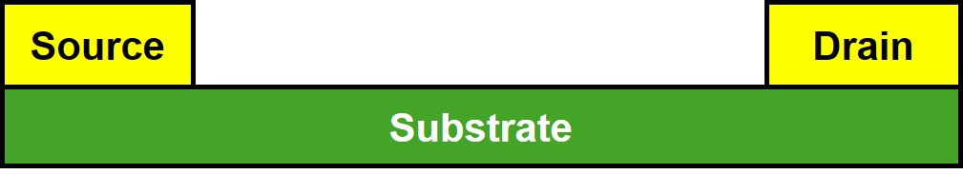
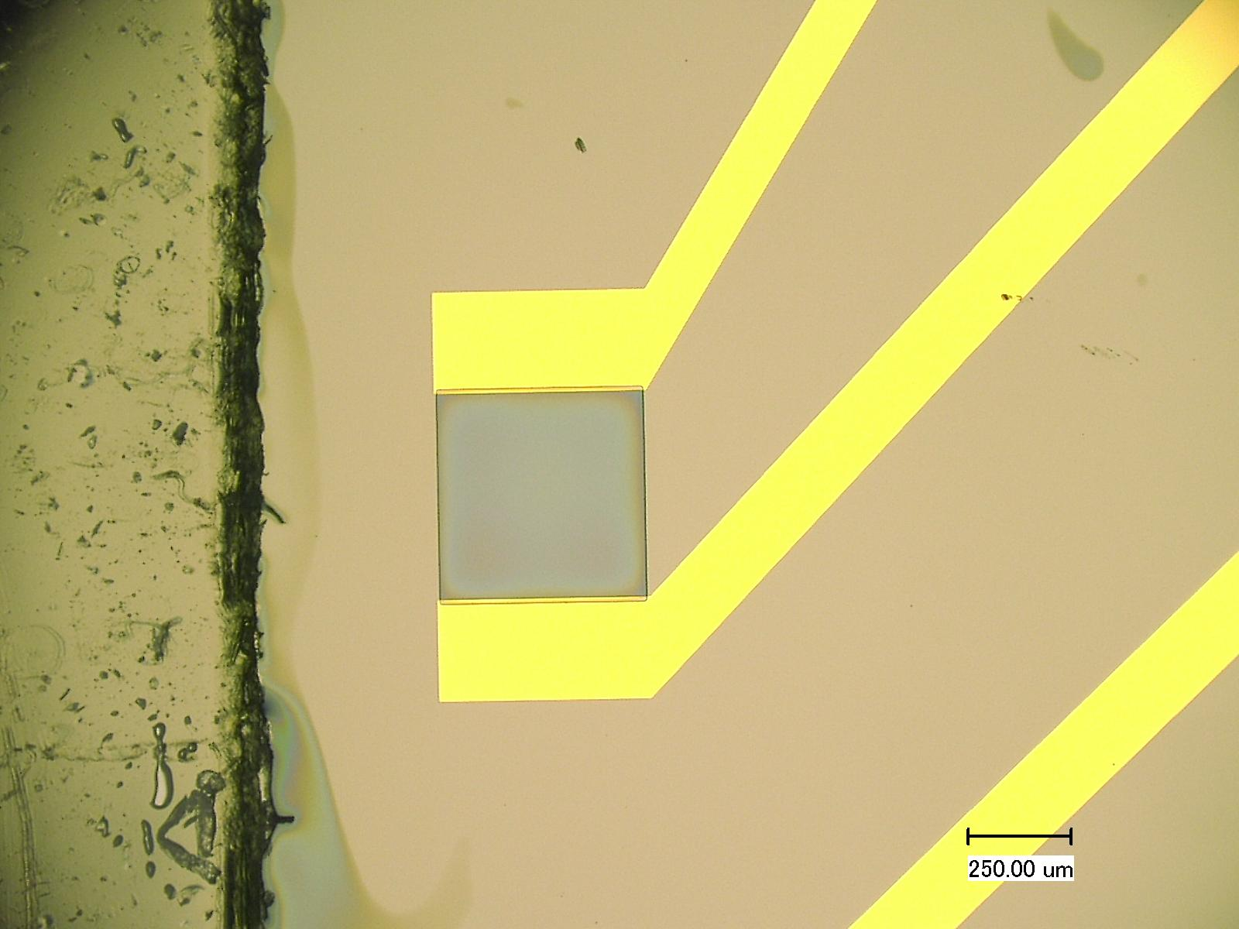
Preparation of OECT for Testing
Masters Project Emmanuel Joseph Shaji
11/11/2025
mPEDOT:PSS
PEDOT:PSS
EG
DBSA
GOPS
Spincoat
(1000rpm for 60s)
Bake
(110°C for 10 min)
mPEDOT:PSS
Bake
(110°C for 10 min)
Spincoat
(1000rpm for 60s)
Pure PEDOT:PSS
mPEDOT:PSS
7
Notes:
External Platinum gate was used because none of the chips had inbuilt Platinum in it. Why I used dual layer channel will be explained later

Slide 10
Enzyme Preparation
Masters Project Emmanuel Joseph Shaji
11/11/2025
GOx
Enzyme
PBS
Buffer
PBS
Buffer
PBS
Buffer
GOx in PBS
Buffer
CaCl₂
PQQ
GOx
GDH
Enzyme
PBS
Buffer
pH 7
PBS
Buffer
MES
Buffer
GDH-PQQ in MES
Buffer
NaOH
GDH
8
Notes:
. They help hold PQQ firmly in the active site, allowing proper electron transfer from glucose to PQQ.
Without Ca²⁺, PQQ can detach or remain inactive, leading to poor or no enzymatic activity.
PQQ (Pyrroloquinoline Quinone) is the redox cofactor (electron carrier) of PQQ–GDH.
It participates directly in the oxidation of glucose to gluconolactone by accepting electrons and protons from glucose.
Enzyme Cofactor Preferred Buffer Reason GDH (PQQ–GDH) PQQ + Ca²⁺
MES Prevents Ca²⁺ precipitation, maintains cofactor stability GOx FAD
PBS Maintains physiological pH, compatible with FAD and O₂ reaction

Slide 11
Experiments done and Glucose Samples tested
Masters Project Emmanuel Joseph Shaji
11/11/2025
Control
No Glucose
Enzyme immobilized
Steady state
1nM | 2nM | 3nM | 4nM | 5nM
Floating Enzyme
Steady state
1nM | 10nM | 100nM | 1µM | 10µM | 100µM | 1mM | 10mM
Floating Enzyme
Real time
1µM | 10µM | 100µM | 1mM | 10mM
9
Notes:
1nM-5nM (Wildau‘s Strategy)
1nM-10mM ( to learn more intermediate concentrations)
1µM-10mM ( Small concentrations didnt show sensing)

Slide 12
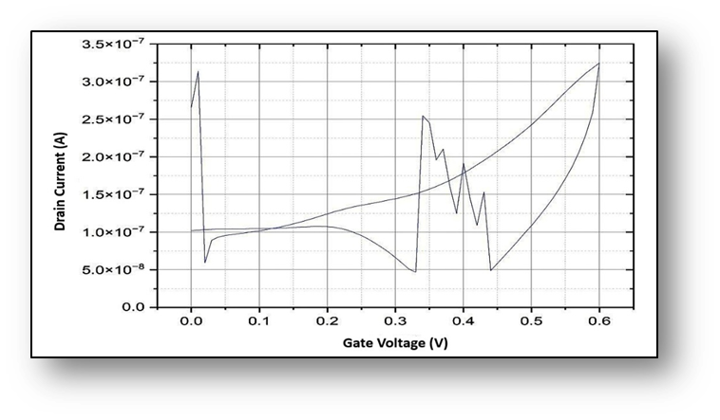
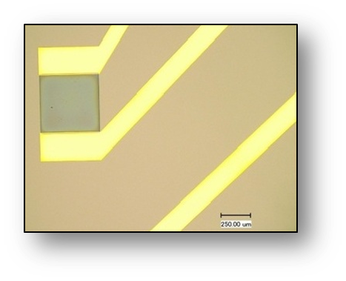
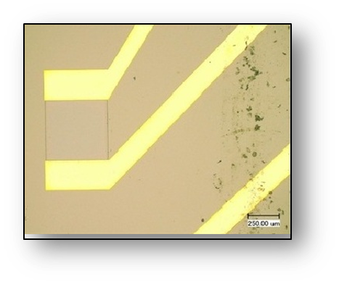
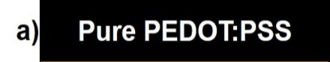
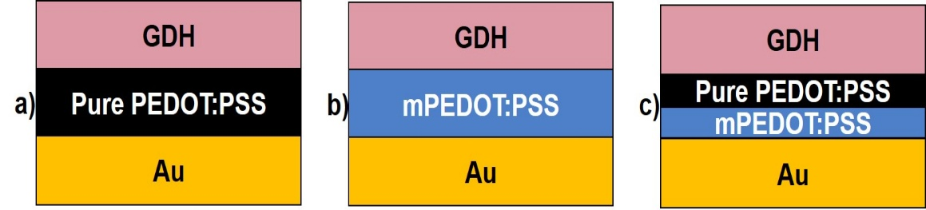
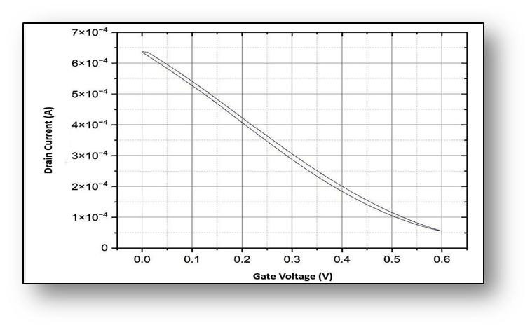
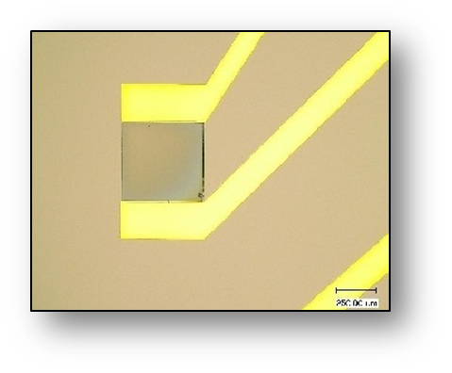
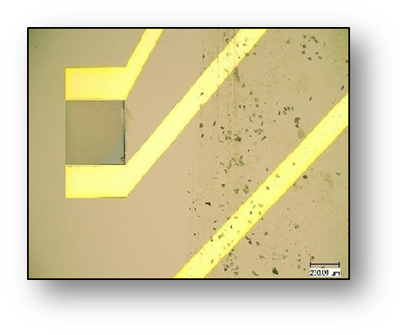
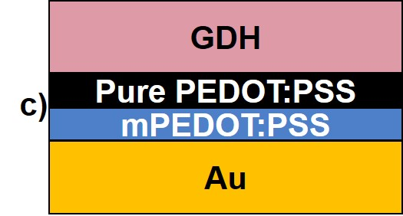
Control Experiment
Masters Project Emmanuel Joseph Shaji
11/11/2025
Vg- 0 V to 0.6 V at a scan rate of 0.01 V/s and Vd constant at –0.2 V with external overhanging Pt gate.
10

Slide 13
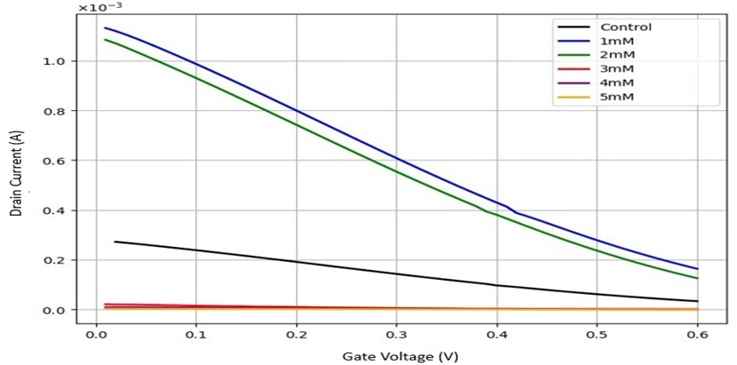
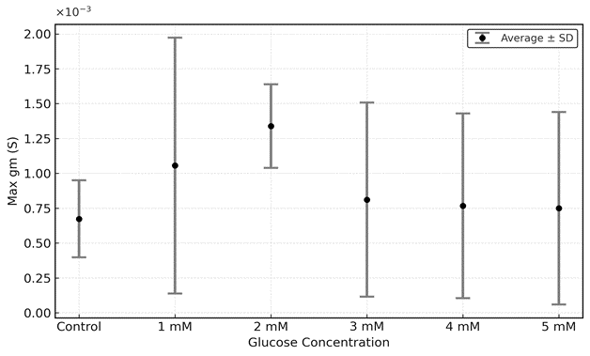
Steady state measurement of OECT with GDH enzyme immobilized on channel
Masters Project Emmanuel Joseph Shaji
11/11/2025
Vg- 0 V to 0.6 V at a scan rate of 0.01 V/s and Vd constant at –0.2 V with external overhanging Pt gate.
Transfer characteristics
Max transconductance vs glucose concentration
11
Notes:
On current (Ion)
Off current (Ioff)
On/Off ratio (Ion / Ioff)
Maximum transconductance (gm)
Average current modulation (|Ioff – Ion| / Ion)

Slide 14
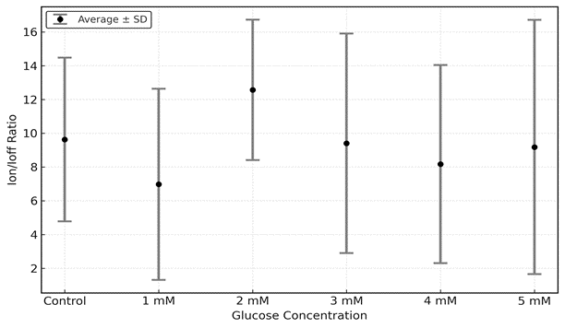
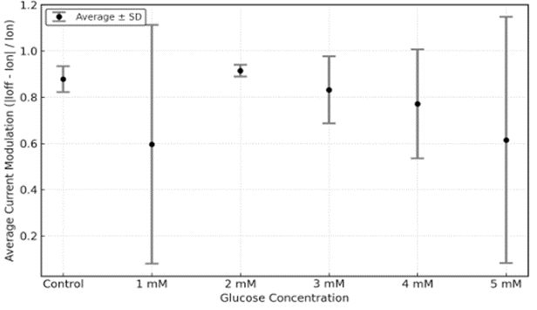
Steady state measurement of OECT with GDH enzyme immobilized on channel
Masters Project Emmanuel Joseph Shaji
11/11/2025
On/Off Ratio vs glucose concentration
Avg current modulation vs glucose concentration
12

Slide 15
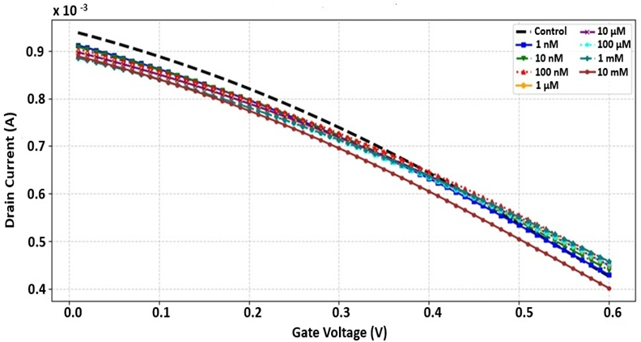
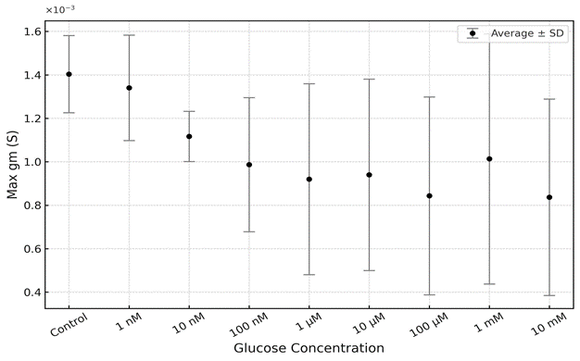
Steady state measurement of OECT with GOx enzyme as floating electrolyte
Masters Project Emmanuel Joseph Shaji
11/11/2025
Vg- 0 V to 0.6 V at a scan rate of 0.01 V/s and Vd constant at –0.2 V with external overhanging Pt gate.
Transfer characteristics
Max transconductance vs glucose concentration
13
Notes:
OECts are sensitive to tiny ionic changes, ions starts to penetrate the channel and reduce its oxidized state(PEDOT⁺ ⁻⁻⁻⁻ PEDOT⁰) as gate voltage is applied. The increase in glucose concentration increase ions

Slide 16
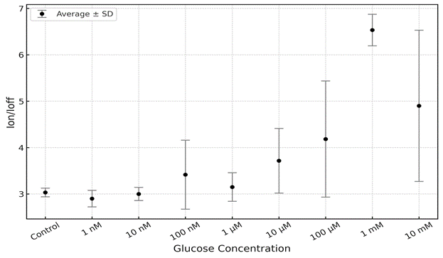
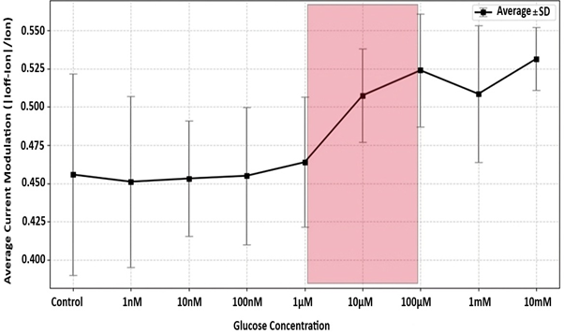
Steady state measurement of OECT with GOx enzyme as floating electrolyte
Masters Project Emmanuel Joseph Shaji
11/11/2025
On/Off Ratio vs glucose concentration
Avg current modulation vs glucose concentration
14

Slide 17
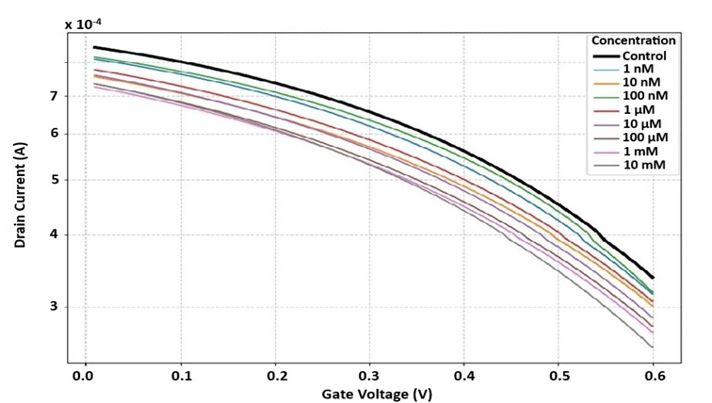
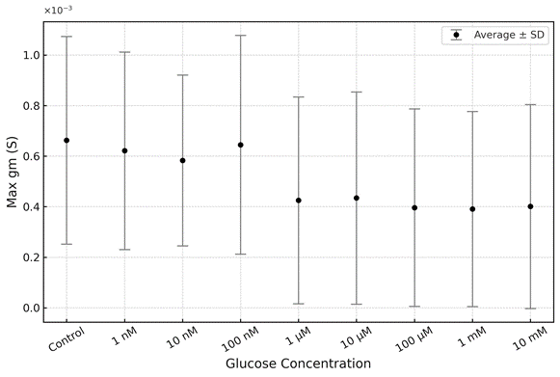
Steady state measurement of OECT with GDH enzyme as floating electrolyte
Masters Project Emmanuel Joseph Shaji
11/11/2025
Vg- 0 V to 0.6 V at a scan rate of 0.01 V/s and Vd constant at –0.2 V with external overhanging Pt gate.
Transfer characteristics
Max transconductance vs glucose concentration
15

Slide 18
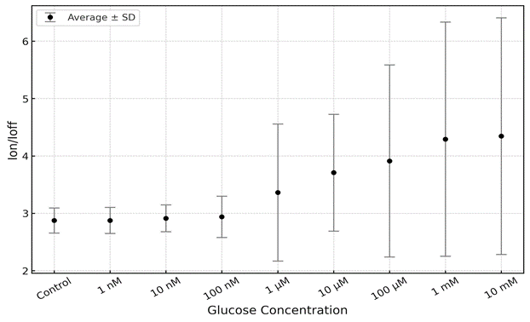
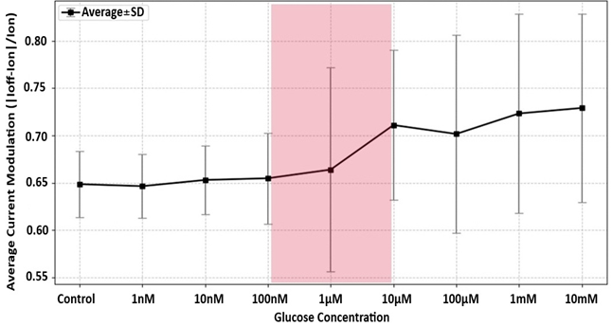
Steady state measurement of OECT with GDH enzyme as floating electrolyte
Masters Project Emmanuel Joseph Shaji
11/11/2025
On/Off Ratio vs glucose concentration
Avg current modulation vs glucose concentration
16

Slide 19
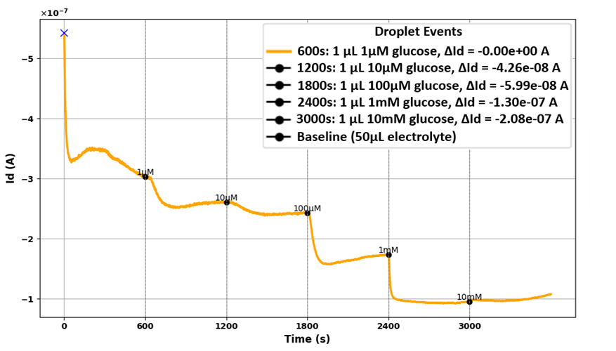
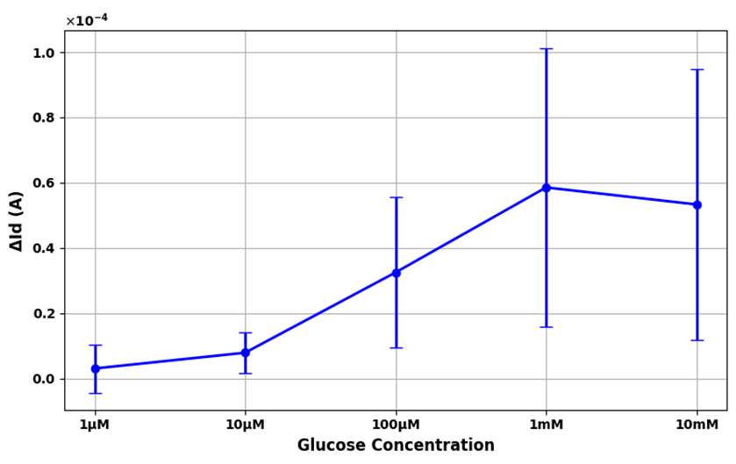
Real time measurement of OECT with GOx enzyme as floating electrolyte
Masters Project Emmanuel Joseph Shaji
11/11/2025
Measurement setup: Drain voltage fixed at Vd = –0.2 V and gate voltage held at Vg = 0.6 V with external overhanging Pt gate.
Id vs time
ΔId vs Glucose concentration
17
Notes:
Id vs Time: Shows real-time current change after each glucose addition.
ΔId vs Glucose Concentration: Shows overall current variation across glucose levels

Slide 20
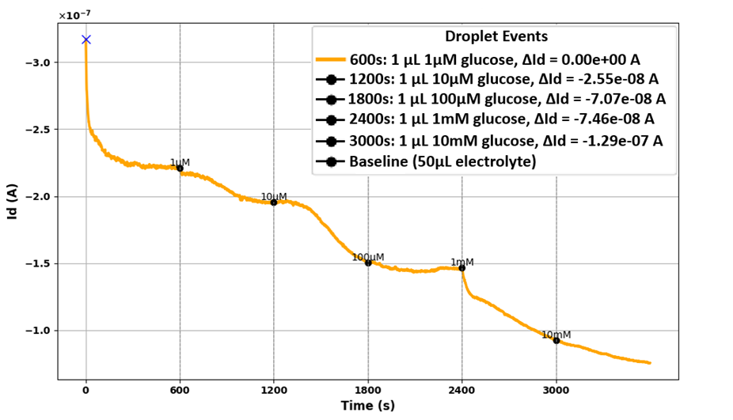
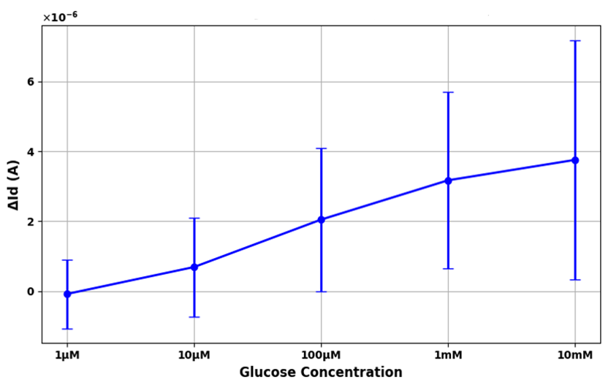
Real time measurement of OECT with GDH enzyme as floating electrolyte
Masters Project Emmanuel Joseph Shaji
11/11/2025
Measurement setup: Drain voltage fixed at Vd = –0.2 V and gate voltage held at Vg = 0.6 V with external overhanging Pt gate.
Id vs time
ΔId vs Glucose concentration
18

Slide 21
Conclusion
Masters Project Emmanuel Joseph Shaji
11/11/2025
In control, dual-layer PEDOT:PSS channels (mPEDOT:PSS + PH1000) showed higher stability and reproducibility than single-layer devices.
Floating-enzyme configuration provided consistent signals, while immobilized enzymes tended to detach.
GOx-based OECTs: qualitative detection (1 µM–100 µM, steady-state) and linear response (10 µM–1 mM, real-time) — ideal for saliva and sweat sensing.
GDH-based OECTs: qualitative detection (100 nM–10 µM, steady-state) and linearity (10 µM–10 mM, real-time) — covering both biofluid and blood glucose levels.
Enzyme type and configuration strongly affect OECT glucose sensing performance and stability.
19

Slide 22
Masters Project Emmanuel Joseph Shaji
11/11/2025
Future Perspectives
Lower gate voltage from 0.6 V to 0.3 V for reaching saturation faster in real-time signals.
Immobilize enzyme on the gate electrode to improve stability and sensitivity.
19

Slide 23

Questions?
Masters Project Emmanuel Joseph Shaji
11/11/2025
20

Slide 24

Masters Project Emmanuel Joseph Shaji
11/11/2025

Slide 25
Masters Project Emmanuel Joseph Shaji
11/11/2025

Slide 26

References
[1] S. Ferri, K. Kojima, and K. Sode, “Review of glucose oxidases and glucose dehydrogenases: a bird's eye view of glucose sensing enzymes,” J. Diabetes Sci. Technol., vol. 5, no. 5, pp. 1068–1076, 2011, doi: 10.1177/193229681100500507.
[2] E. M. Thaning, M. L. M. Asplund, T. A. Nyberg, O. W. Inganäs, and H. von Holst, “Stability of poly(3,4-ethylene dioxythiophene) materials intended for implants,” J. Biomed. Mater. Res. Part B Appl. Biomater., vol. 94B, no. 1, pp. 254–262, 2010, doi: 10.1002/jbm.b.31597.
[3] C. O. Malikkides and R. H. Weiland, “On the mechanism of immobilized glucose oxidase deactivation by hydrogen peroxide,” Biotechnol. Bioeng., vol. 74, no. 1, pp. 109–116, 2001, doi: 10.1002/bit.260241109.

Slide 27
Quantity | Low glucose | Medium glucose | High glucose (saturation)
I_ON | High | Decreasing | Constant (saturated)
I_OFF | Low | Decreasing | Constant (saturated)
Transconductance | High | Decreasing | Plateau / minimum
On–off ratio | Moderate | Increasing | Saturated / plateau
Current modulation | Moderate | Increasing | Saturated / plateau

Slide 28
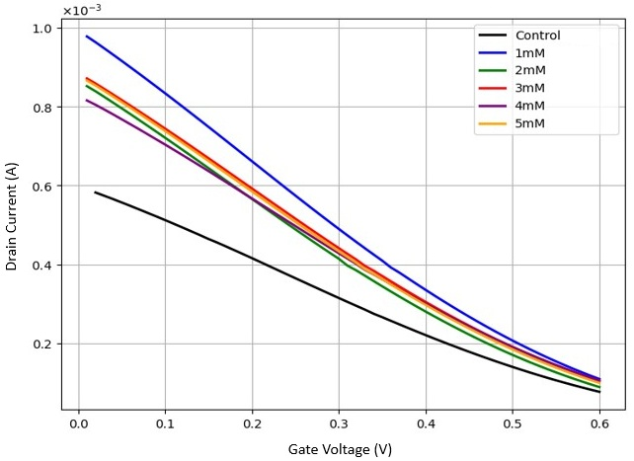
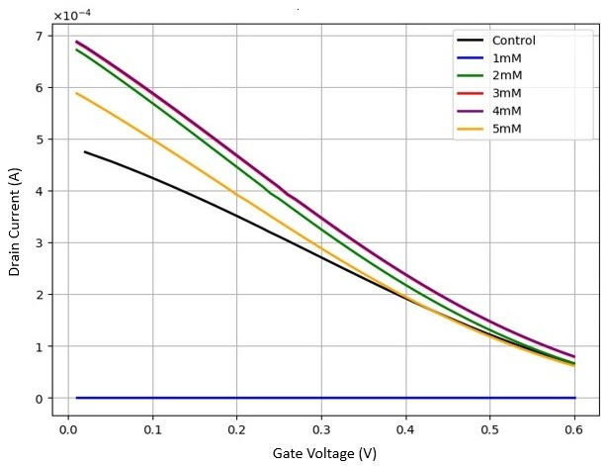
Appendix
Masters Project Emmanuel Joseph Shaji
11/11/2025
1.Steady state measurement of OECT with GDH enzyme immobilized on channel
OECT 2
OECT 3
22

Slide 29
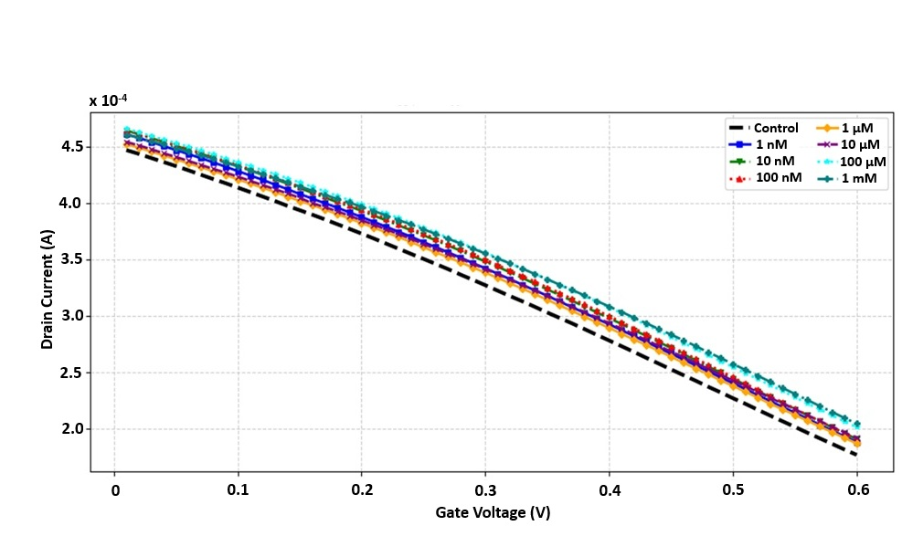
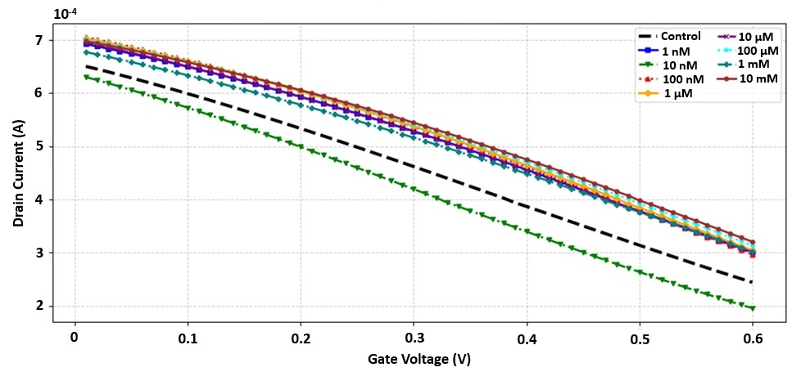
Appendix
Masters Project Emmanuel Joseph Shaji
11/11/2025
2.Steady state measurement of OECT with GOx enzyme as floating electrolyte
OECT 2
OECT 3
23

Slide 30
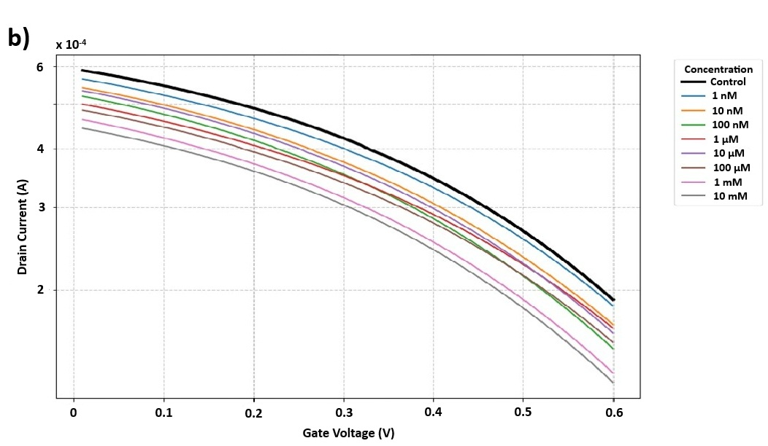
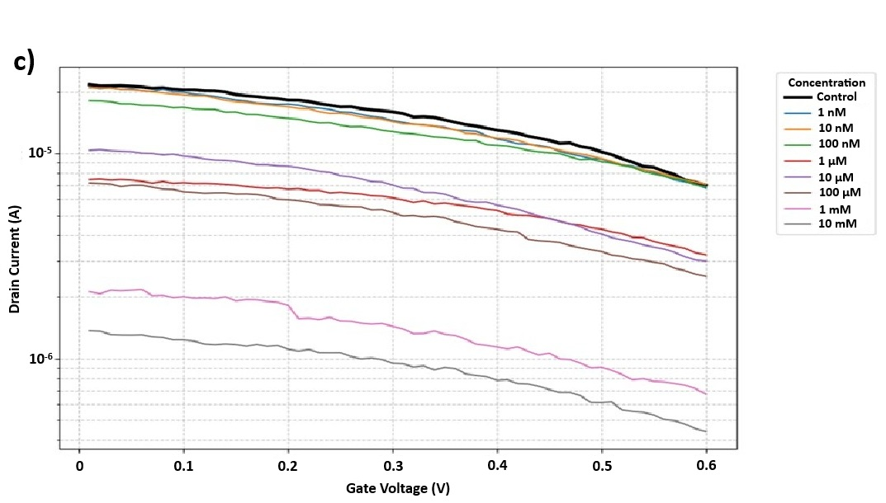
Appendix
Masters Project Emmanuel Joseph Shaji
11/11/2025
3.Steady state measurement of OECT with GDH enzyme as floating electrolyte
OECT 2
OECT 3
24

Slide 31
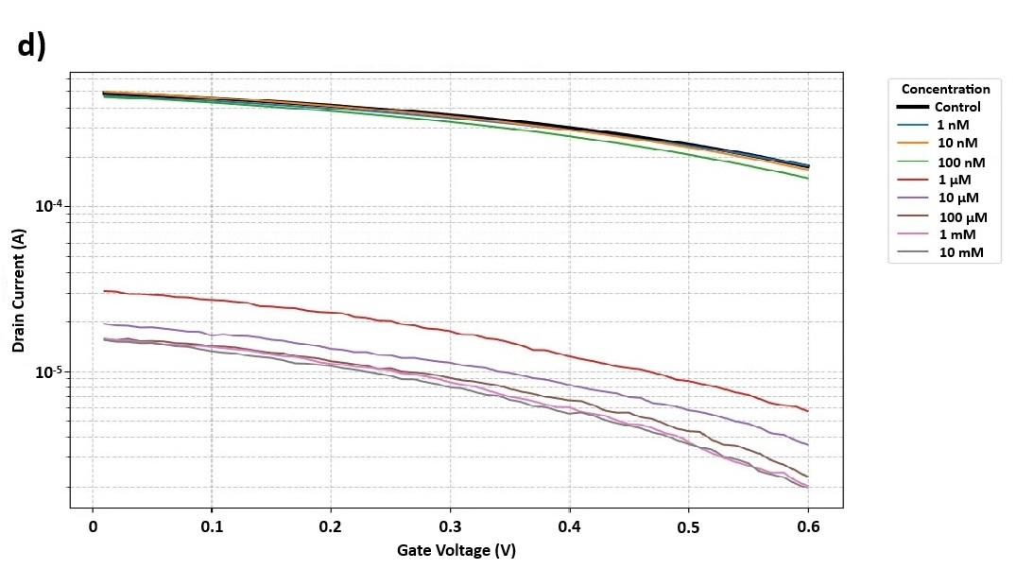
Appendix
Masters Project Emmanuel Joseph Shaji
11/11/2025
3.Steady state measurement of OECT with GDH enzyme as floating electrolyte
OECT 4
25

Slide 32
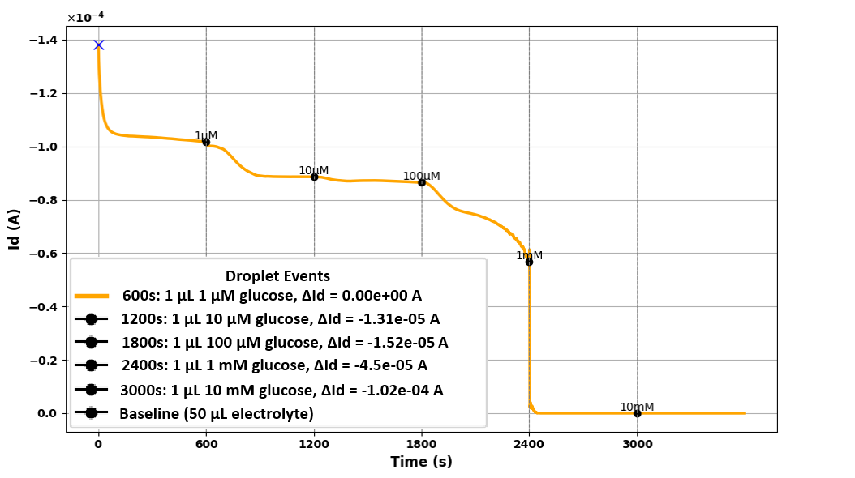
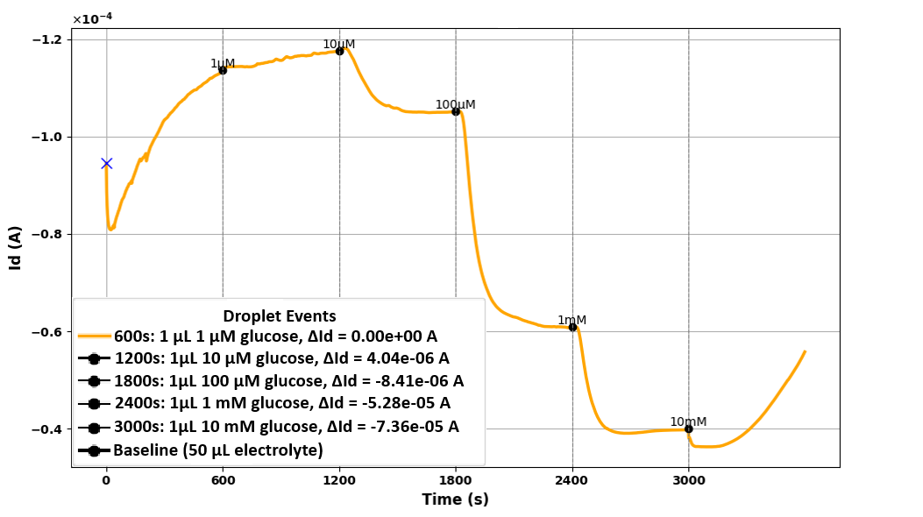
Appendix
Masters Project Emmanuel Joseph Shaji
11/11/2025
4.Real time measurement of OECT with GOx enzyme as floating electrolyte
OECT 2
OECT 3
26

Slide 33
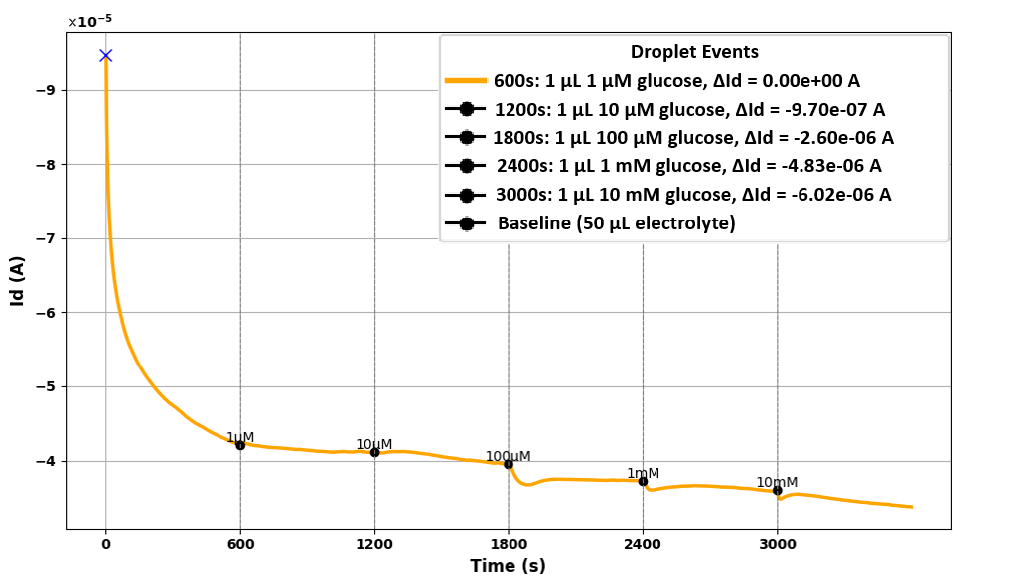
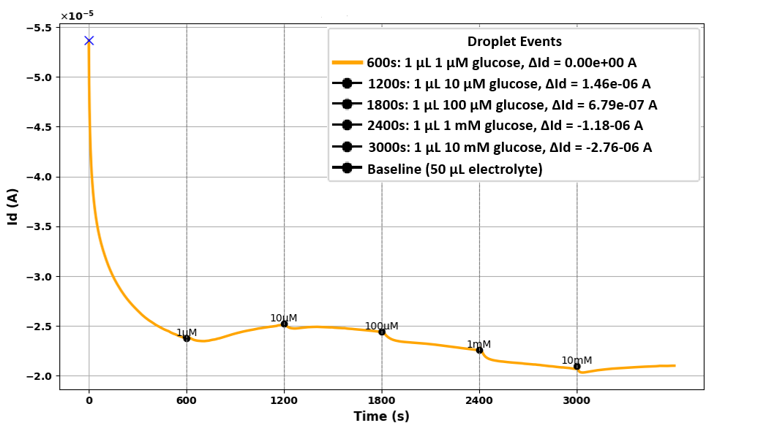
Appendix
Masters Project Emmanuel Joseph Shaji
11/11/2025
5.Real time measurement of OECT with GDH enzyme as floating electrolyte
OECT 2
OECT 3
27

Slide 34
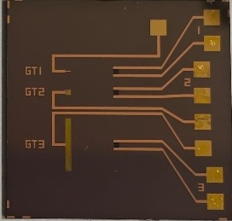
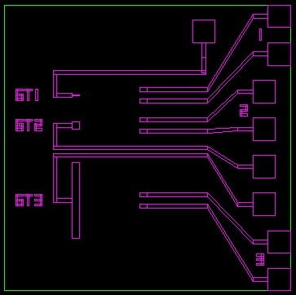
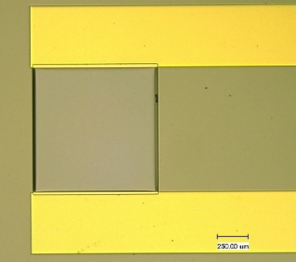
6.Fabrication of OECT
Masters Project Emmanuel Joseph Shaji
05/11/2025
Appendix
Mask Design and Layout
Chip layout (21 × 21 mm) with 3 channels (500 × 500 µm) designed in AutoCAD and aligned on wafer template
2. Electrode Deposition and Patterning
Gold source, drain, and gate interconnects patterned on Si/SiO₂ wafer using photolithography and PI insulation layers
3. PEDOT:PSS Deposition
Modified PEDOT:PSS (with EG, DBSA, GOPS) spin-coated, baked at 110 °C, similarly pure PEDOT:PSS on top and sacrificial PI layer lifted off to form final channel.
28
Notes:
1.Mask Design and LayoutDesigned electrode and channel geometries in AutoCAD (21 mm × 21 mm chip)Included three 500 μm × 500 μm channels and in-plane Pt gates (GT1–GT3) Overhanging platinum-coated glass electrode used as gate during testing Layout exported in .dxf format and aligned using wafer template(Each chip design is aligned by snapping its bottom-left corner to the top-right corner of a positioning square on the wafer template.)
2. Electrode Deposition and Patterning-Started with thermally oxidized Si wafer (SiO₂ ≈ 500 nm) for insulation. Surface treated with APTES → improved adhesion for polyimide (PI)First PI layer spin-coated and cured as adhesion/buffer layer. Gold film sputtered and patterned (source, drain, gate lines) via first photolithography, Second- Third PI layer added as sacrificial layer for later lift-off Second photoresist (PR2) applied to define contact vias and channels. Reactive-ion etching (RIE) used to open via holes and define channels. PR2 removed after etching.
3. PEDOT:PSS Deposition Formulated modified PEDOT:PSS (mPEDOT:PSS):PEDOT:PSS (Clevios PH1000) + 5% EG + 0.1% DBSA + 1% GOPS Mixed and stirred for 15 minutes Spin-coated (1000 rpm, 1 min) onto exposed channel region Baked at 110 °C for 10 min for solvent removal Sacrificial PI layer lifted off, revealing final channel geometry

Slide 35
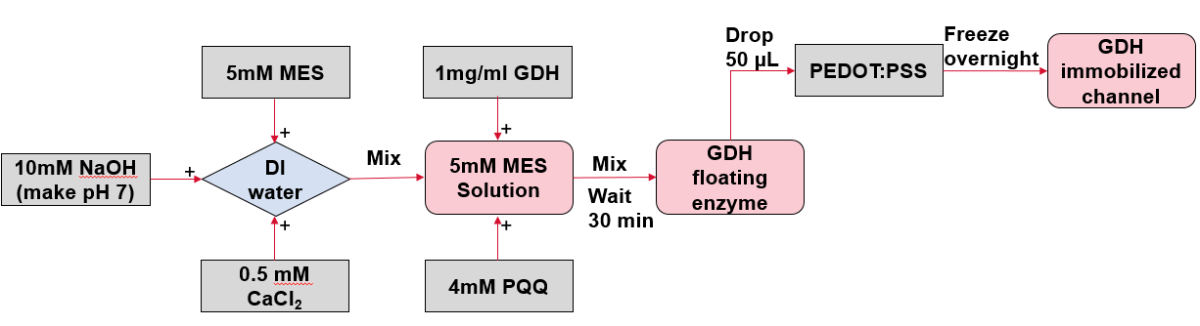

7.Enzyme Preparation
Masters Project Emmanuel Joseph Shaji
05/11/2025
Appendix
GDH
GOx
29
Notes:
Glucose Oxidase specific activity=360U/mg
Unit/Volume needed=500 U/ml
Required mass=specific activity/Unit/Volume=1.39mg/ml
Volume prepared=5mL
Unit/Volume Prepared=5ml*1.39mg/ml=6.95mg

Slide 36


8.Glucose Preparation
Masters Project Emmanuel Joseph Shaji
05/11/2025
Appendix
MES
(GDH)
MES
(GDH)
PBS
(GOx)
30

Slide 37
Motivation Slide
Masters Project Emmanuel Joseph Shaji
11/11/2025
Non invasive
Non invasive
Non invasive
Well established
Real time detection
Simple design
Real time detection
High sensitivity
Light scattering & Tissue absorption
Indirect measurement
Complex circuitry
Invasive
Expensive
No real time detection
Still in study phase
Temparature and pH dependent
2
Notes:
Optical glucose sensing: Detects glucose through changes in light absorption, fluorescence, or scattering caused by glucose–enzyme or glucose–indicator interactions.
Urine/Saliva glucose testing: Determines glucose concentration by measuring the color change of a dye after enzymatic oxidation, compared to an optical or color reference.
Microwave/Impedance glucose sensing: Senses glucose by monitoring variations in dielectric properties or impedance of the sample as glucose concentration alters its conductivity and permittivity.
Electrochemical glucose sensing: Measures electrical current or potential generated by the enzymatic oxidation of glucose, proportional to its concentration.

Slide 38
Vgs
Electrolyte + GOx
Gate
Pure PEDOT:PSS
mPEDOT:PSS
Electrolyte
Source
Drain
Vds
Substrate

Slide 39
GDH
a)
Pure PEDOT:PSS
Gate
Au
b)
GDH
Electrolyte
mPEDOT:PSS
Au
GDH
Source
Pure PEDOT:PSS
Drain
c)
Pure PEDOT:PSS
mPEDOT:PSS
mPEDOT:PSS
Substrate
Au

Slide 40
OECT fabrication with 3 PI layers
Universität Bremen
IMSAS
Institute for Microsensors,
-actuators and -systems
Faculty 01
Physics / Electrical Engineering
Henrique F. P. Barbosa
Bremen 08.01.2024

Slide 41

Wafer
Au sputtering over PI
PR1 deposition
1st Mask exposure
MA
APTES: adhesion promoter
Mask
PR1
PR1
Au
Au
Au
PI
PI
PI
SiO2
SiO2
SiO2
SiO2
Si
Si
Si
Si
Post-1st exposure
Mask removal
PR1 development
Au etching
Mask
PR1
PR1
Au
Au
Au
PI
PI
PI
PI
SiO2
SiO2
SiO2
SiO2
Si
Si
Si
Si

Slide 42

PR1 removal
Short RIE exposure
PI double layer deposition
PR2 deposition
RIE
PR2
PI
PI
PI
PI
PI
PI
PI
PI
SiO2
SiO2
SiO2
SiO2
Si
Si
Si
Si
2nd Mask exposure
Post-2nd exposure
Mask removal
PR2 development
MA
Mask
Mask
PR2
PR2
PR2
PR2
PI
PI
PI
PI
PI
PI
PI
PI
PI
PI
PI
PI
SiO2
SiO2
SiO2
SiO2
Si
Si
Si
Si

Slide 43
RIE
Post-RIE
PR2 removal
OSC deposition
RIE
Ag
PR2
PR2
OSC
PI
PI
PI
PI
PI
PI
PI
PI
PI
PI
PI
PI
SiO2
SiO2
SiO2
SiO2
Si
Si
Si
Si
PI top layer peeling
(structuring)
Ag
LAYER SIZES
PI
4.7 µm
PI
200 nm
PI
300 nm
PI
PI
4.7 µm
SiO2
SiO2
500 nm
Si
Si

